Slide 1


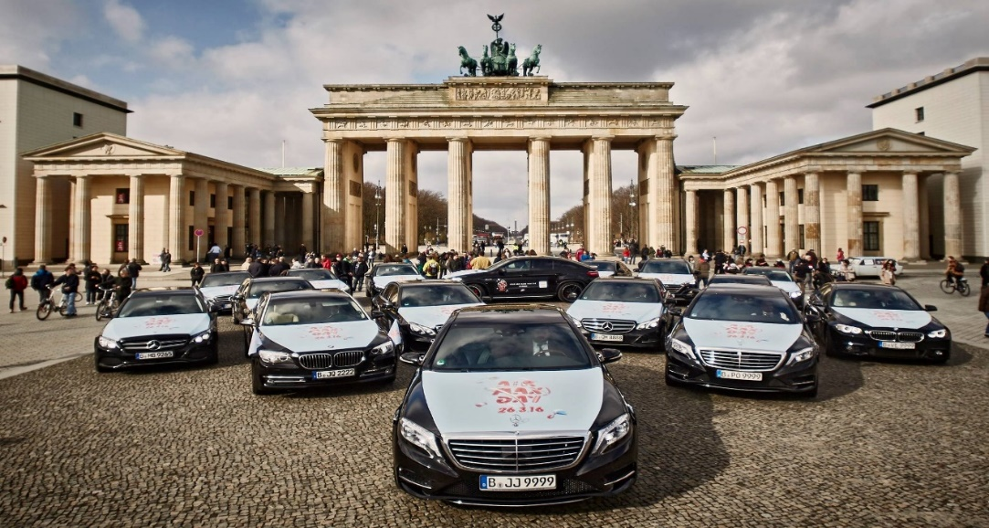
Battle of Neighborhood's
Finding The Best Pivot Area For Cab Drivers in Berling.
By Guray CERMAN
IBM Professional Data Science Certification Coursera Capstone Project .

Slide 2
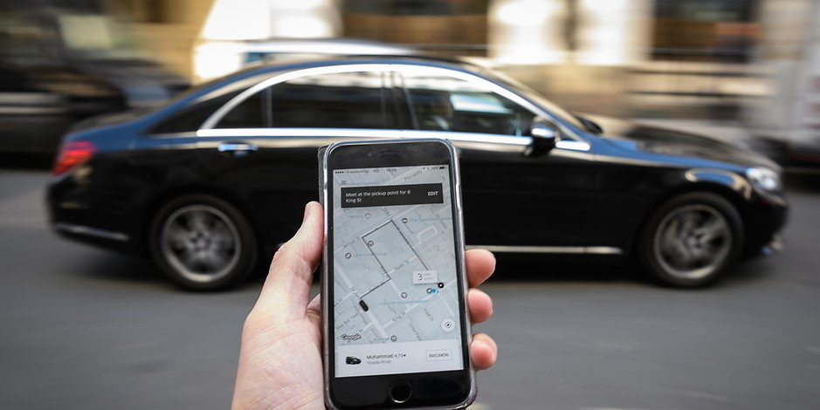
Table of Contents
Introduction: Business Problem
Data
Methodology
Results
Discussion
Conclusion

Slide 3
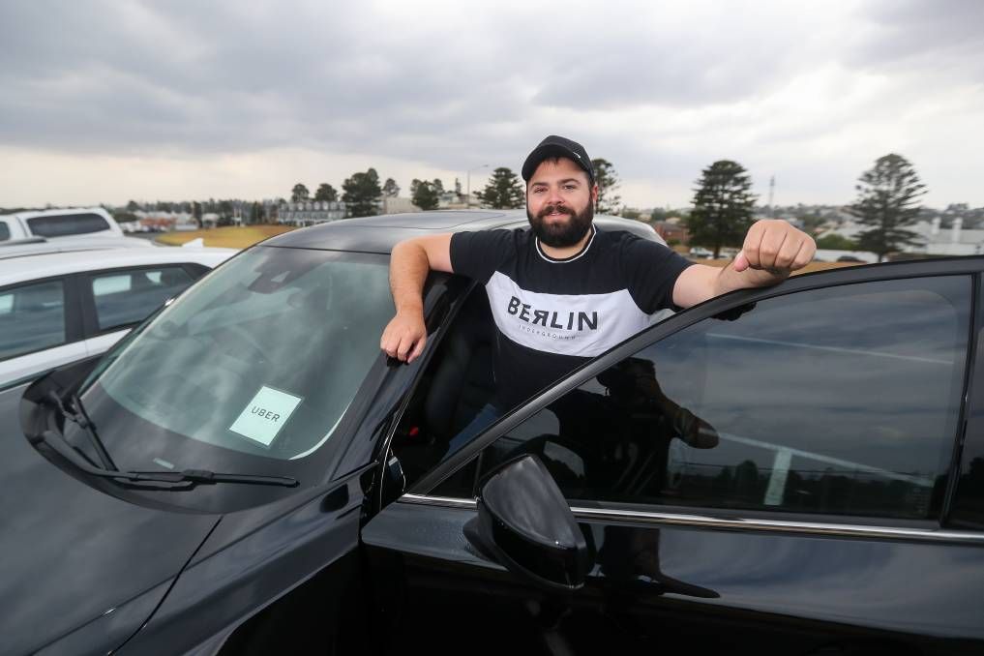
Introduction: Business Problem
A person wants to dive into taxi business in Berlin. He wants to be a non-conventional cab driver and work independently as a member of UBER or MyTaxi organizations. He has a limited budget and he wants to maximize his profits.
At this point, we want to help him by determining a pivot area in Berlin where he can easily find clients and minimize his costs of driving without a client, in due course.
Taxi Business

Slide 4
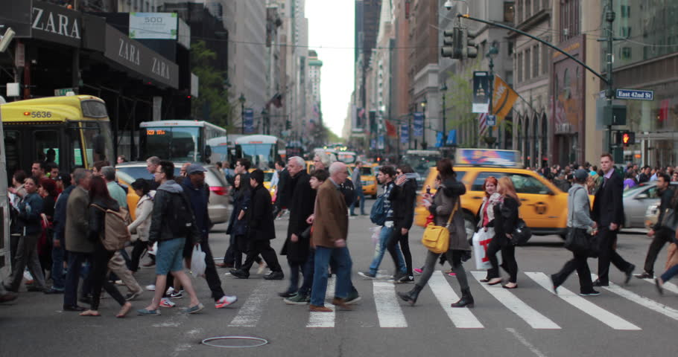
Introduction: Business Problem
People commute in metropoles based on patterns.
Season (sommer, winter etc),
The day type (weekday or weekend),
The time period of the day (morning, noon, afternoon, night) has great effect on these patterns.
Movement Patterns of People

Slide 5

Introduction: Business Problem
Daily Routine;
From Home to Work,
From work to Home,
From work to recreation areas or venues,
From venues to Home
Weekends;
From homes to recreation areas or venues,
Vice versa
Sommer period;
From hotels to touristic areas,
Vice versa
Movement Patterns of People
Venues

Slide 6
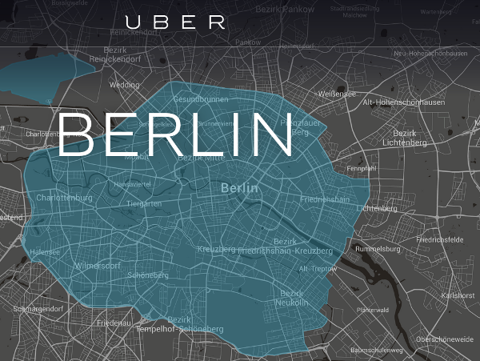
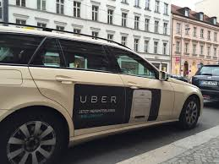
Introduction: Business Problem
Non-conventional taxi business : UBER and MyTaxi,
Both work online on applications
The algorithm directs cabs to cab calling clients based on finding nearest available cab.
Non Conventional Taxi Business
Venues
More Clients
Finding best pivot area for cabs helps !!!

Slide 7
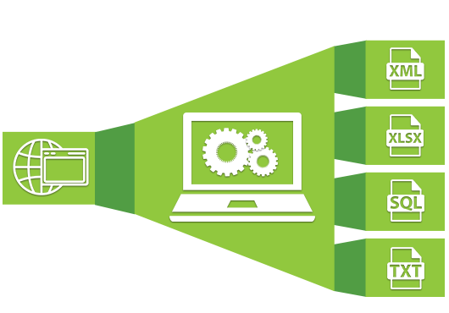
Data : Sources /Web Scraping
REQUIREMENTS
List of all the boroughs in Berlin with all zipcodes belonged to this boroughs
Geopraphical positions (Latitude-Longitude) of all zipcodes within these boroughs
List of all venues in boroughs
List of Top rated Venues
SOURCE
http://www.statistik-berlin-brandenburg.de/produkte/verzeichnisse/zuordnungderbezirkezupostleitzahlen.xls
https://raw.githubusercontent.com/TrustChainEG/postal-codes-json-xml-csv/master/data/DE/zipcodes.de.csv
https://raw.githubusercontent.com/m-hoerz/berlin-shapes/master/berliner-bezirke.geojson
Foursquare API
For all Venues in Berlin.
YELP API
For top rated Venues in Berlin.

Slide 8
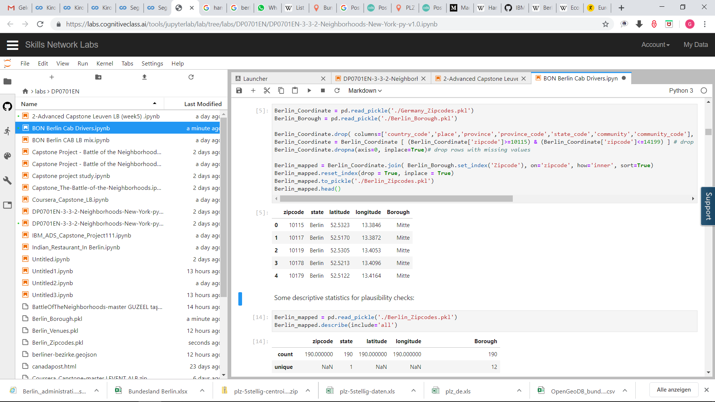
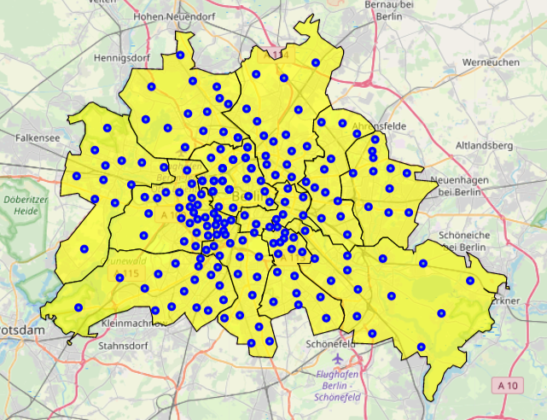
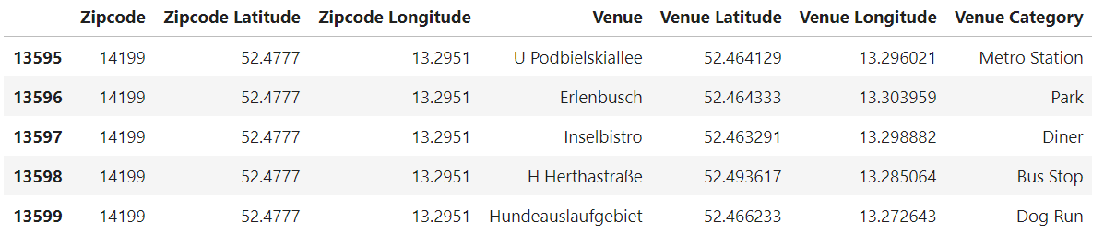
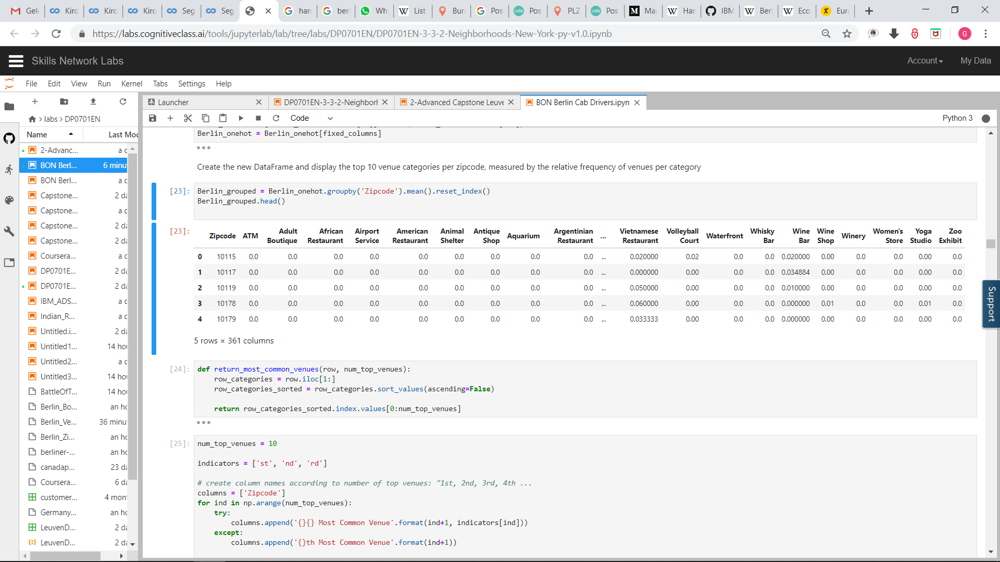
Data : Data Wrangling
Boroughs and Neighbourhoods of Berlin

Slide 9
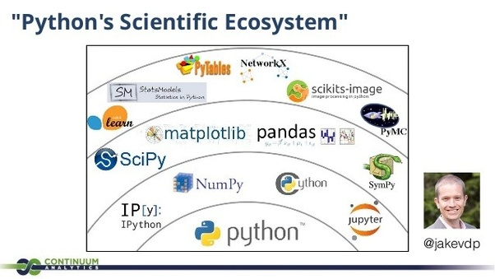
Data : Python Libraries
Pandas, Numpy – Libraries for data storage, manipulation and array computing
Scipy – Library for dendrogram and hierarchical cluster analysis
Matplotlib, Folium – Libraries for representing numeric and locational data
Geopy – Library to retrieve locational data
Json – Library to handle JSON files
Requests, Urllib – Libraries to retrieve data and handle http exchange with the Foursquare API and Yelp API.

Slide 10
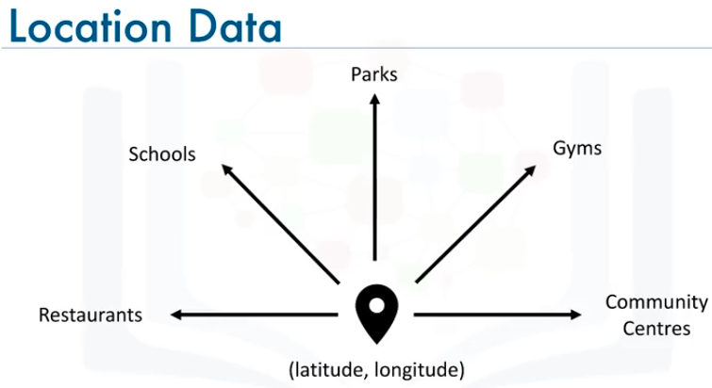
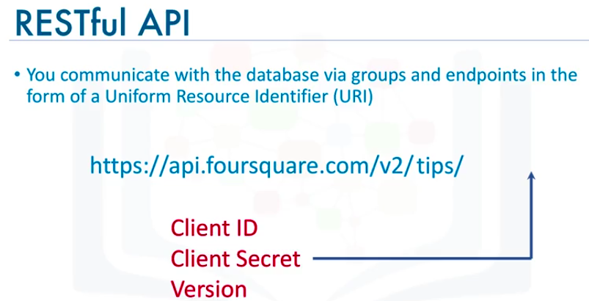
Location Data Provider – Foursquare
1
Location Data
Location data is data describing places and venues, such as their geographical location, their category, working hours, full address, and so on, such that for a given location given in the form of its geographical coordinates (or latitude and longitude values) one is able to determine what types of venues exist within a defined radius from that location.
2
Foursquare
Foursquare is a technologic company that built a massive dataset of accurate location data.
Foursquare powers location data for Apple, Uber, Snapchat, Twitter and many more.
Their API and location data is currently being used by over 100,000 developers.

Slide 11
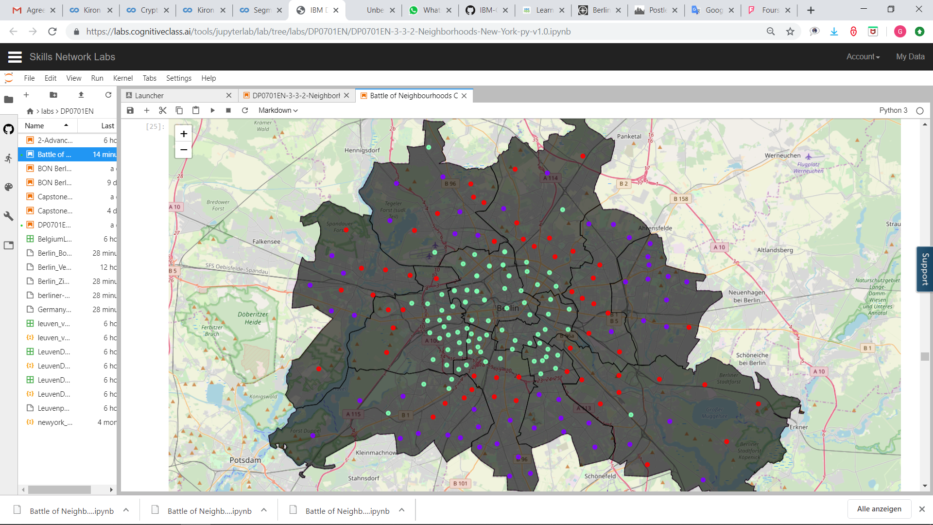
METHODOLOGY : General
To suggest the best Location ,steps followed are -
Using necessary methods, Web pages containing information about Berlin are scraped into Pandas Dataframe.
Dataframe contained data about zipcodes, Coordinates and boroughs. Than Dataframe was Cleaned and Processed according to requirement of the problem to be solved. Proper benchmarks were set to obtain the best results.
The List of Venues in a City were obtained using Foursquare API and the cluster area with maximum weight according to the Model is selected.
With the help of Unsupervised Machine Learning Algorithm (K Means Algorithm) pivot area in the city of Berlin is obtained where a cab driver has to expect more clients and revenues.
1
2
3
4

Slide 12

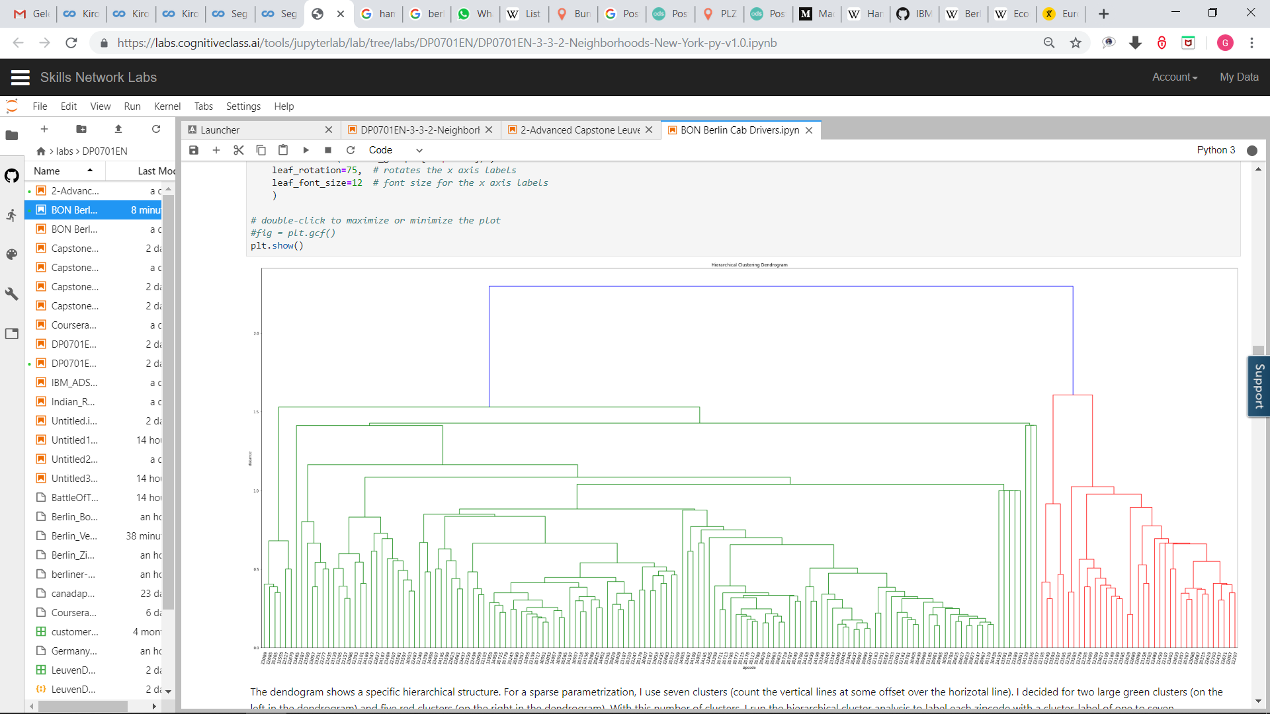
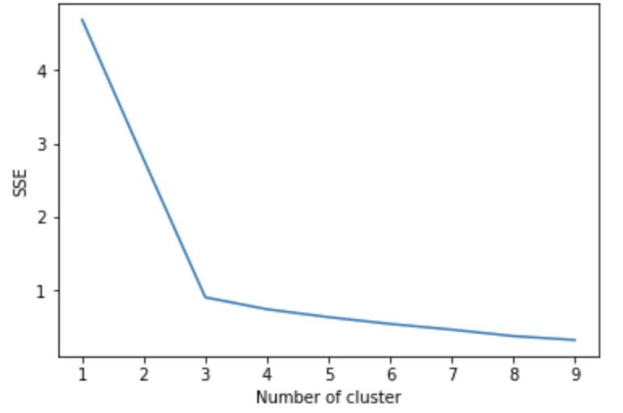
METHODOLOGY : General
Four Square API Calls to Collect Neighborhood Venue Category and LAT/LNG
Cluster 1
One Hot Encoding to Convert Labels into Numbers
Venues Grouped by Neighborhood
K-Means Clustering
Cluster 2
Cluster 3
Dendogram
Elbow Method

Slide 13
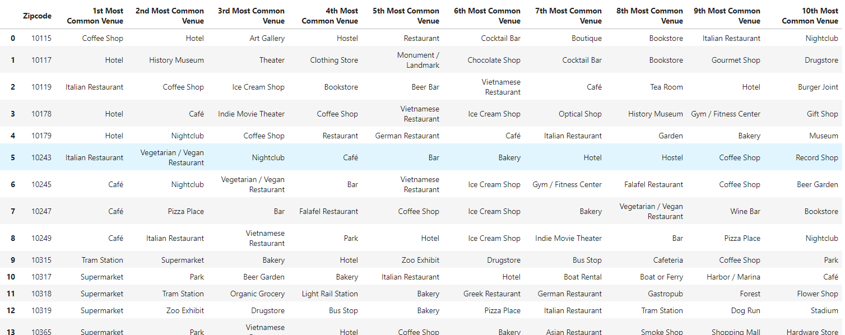
METHODOLOGY : Exploring Venues

Slide 14
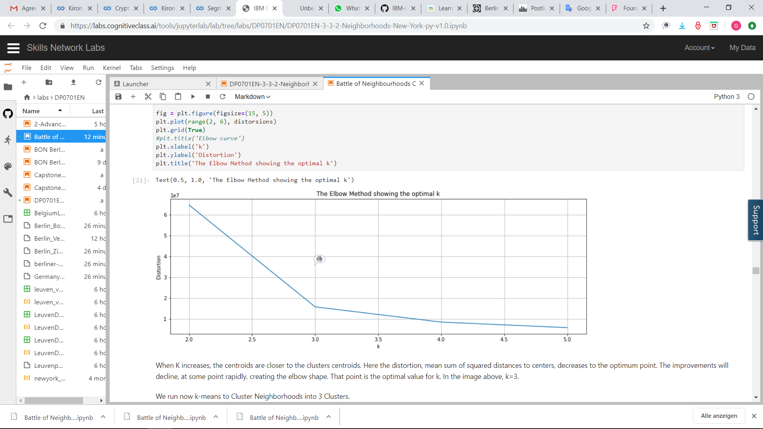
METHODOLOGY : K- Means Clustering (Elbow Method)
When K increases, the centroids are closer to the clusters centroids. Here the distortion, mean sum of squared distances to centers, decreases to the optimum point.
The improvements will decline, at some point rapidly, creating the elbow shape. That point is the optimal value for k.
K=3
K-Means Clustering

Slide 15
RESULTS : Clusters
Cluster 2 (LIGHT GREEN)
It lies around the center of Berlin. The boroughs it encompasses together with the portions are; Mitte (% 100), Friedrichshain-Kreuzberg (% 100), Charlottenburg Wilmersdorf (% 45), Tempelhof Schöneberg (% 25), Neuköln (% 20),Pankow (% 25), Steglitz Zehlendorf (% 15).

Slide 16
RESULTS : Clusters
Cluster 3 (RED)
It is mainly located towards outwards of center of Berlin. It lies as an outer boundry around Cluster 2. The boroughs it encompasses together with the portions are: Treptow-Köpenick (% 75) Lichtenberg (% 60) Pankow (% 40) Reinickendorf (% 20) Charlottenburg-Wilmersdorf (% 20) Spandau (% 30) Steglitz-Zehlendorf (% 10).

Slide 17
RESULTS : Clusters
Cluster 1 (BLUE)
It is mainly located more outwards from Berlin center than Cluster 3 . It lies as an outer bound around both Clusters 2 and 3. The boroughs it encompasses together with the portions are: Marzahn-Hellersdorf (% 90) Lichtenberg (% 15) Pankow (% 5) Reinickendorf (% 45) Spandau (% 30) Steglitz-Zehlendorf (% 40) Tempelhof Schöneberg (% 35 Neuköln (% 35) Treptow-Köpenick (% 15) Marzahn-Hellersdorf (% 80)

Slide 18
RESULTS : Clusters
Pivot Area
Cluster 2
Cluster 1
Important venue categories in this Cluster are: 'Big Box Store', 'Bus Stop', 'Drugstore', 'Electronics Store', 'German Restaurant', 'Park', 'Supermarket'.
This cluster includes 80 zipcodes.
Cluster 3
Important venue categories in this Cluster are: 'Big Box Store', 'Bus Stop', 'Drugstore', 'Electronics Store', 'German Restaurant', 'Park', 'Supermarket‘.
This cluster includes 52 zipcodes.
Important venue categories in this Cluster are: 'Bakery', 'Big Box Store', 'Café', 'Chinese Restaurant', 'Drugstore', 'Greek Restaurant', 'Park', 'Supermarket'.
This cluster includes 54 zipcodes.

Slide 19
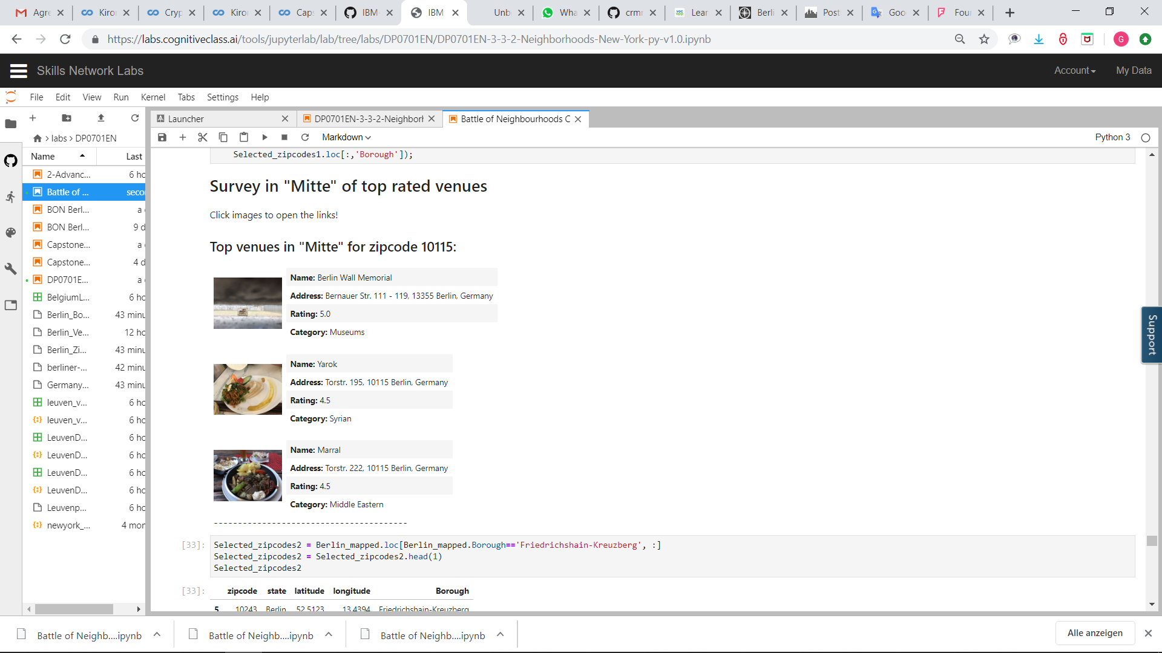
Results : Exploring Top Rated Venues
Performed for Cluster-2;
For each zipcode 3 Survey Made
Top Rated Venues Info Contributes Pivot Area Problem
Cluster-2

Slide 20
Discussion: Recommendations
394 unique categories
12678 venues
This Methodology can be implemented to different metropoles
Real time meteorological data,
Availability of Public Transport,
Can be added to the data set
Real time people food data is very important for cab drivers.
Cab drivers should patrol around top rated venues in Cluster-2

Slide 21
Conclusion
Cluster-2 is most fruitful as far as cab clients concerned.
Cab drivers should focus on top rated venues in Cluster-2
Next Alternative
Cluster-3
Next Alternative
Cluster-1

